Slide 1
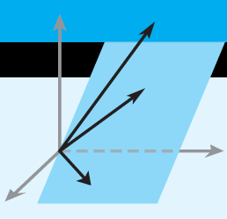
Elementary Linear Algebra
Howard Anton Copyright © 2010 by John Wiley & Sons, Inc.
All rights reserved.
Chapter 4
Notes:
*

Slide 2
Chapter 4 General Vector Spaces
4.7 Row Space, Column Space, and Null Space
4.8 Rank, Nullity, and the Fundamental Matrix Spaces
4.9 Matrix Transformations from R^{n} to R^{m}
4.10 Properties of Matrix Transformations
4.11 Geometry of Matrix Operators on R²
Notes:
*

Slide 3
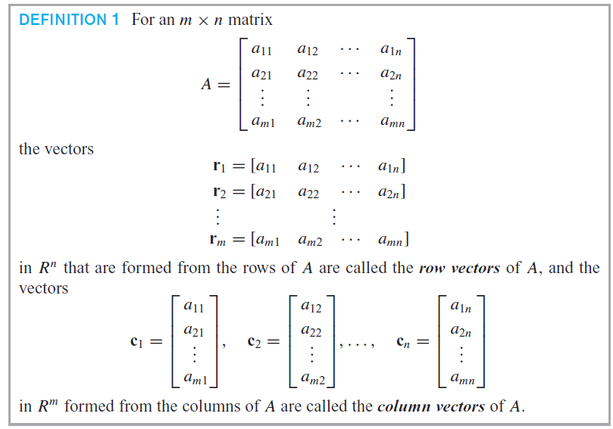
Row Space, Column Space, and Null Space
Notes:
*

Slide 4
Row, column and null spaces
Notes:
*

Slide 5
Systems of linear equations
Notes:
*

Slide 6
A basis for span (S)
Notes:
*

Slide 7
Rank and Nullity
Notes:
*

Slide 8
Notes:
*

Slide 9
Fundamental Spaces of Matrix A
Row space of A
Null space of A
Column space of A
Null space of A^{T}
Notes:
*

Slide 10
Notes:
*

Slide 11
Matrix Transformations from R^{n} to R^{m}
Notes:
*

Slide 12
Properties of Matrix Transformations
Notes:
*

Slide 13
Notes:
*

Slide 14
Notes:
*

